Slide 1
Attention is All You Need
Umar Jamil
https://www.youtube.com/watch?v=bCz4OMemCcA&t=1275s

Slide 2
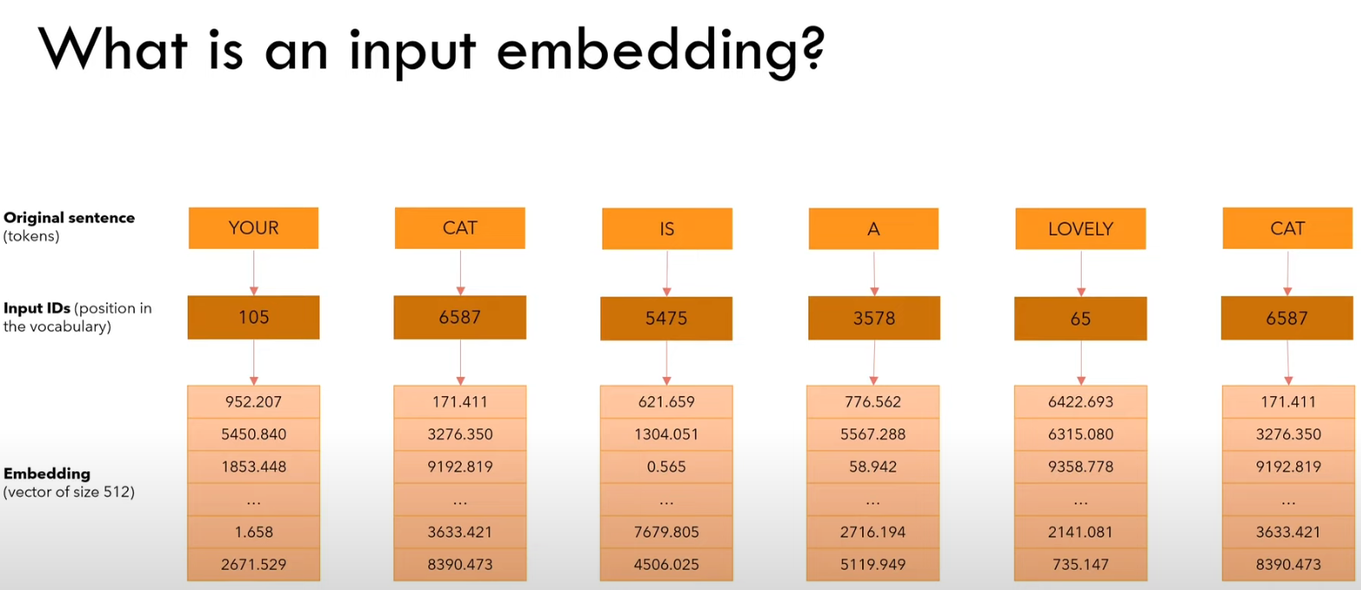
Convert Words into Numbers Sentence -> Tokens -> Ids -> Embeddings

Slide 3
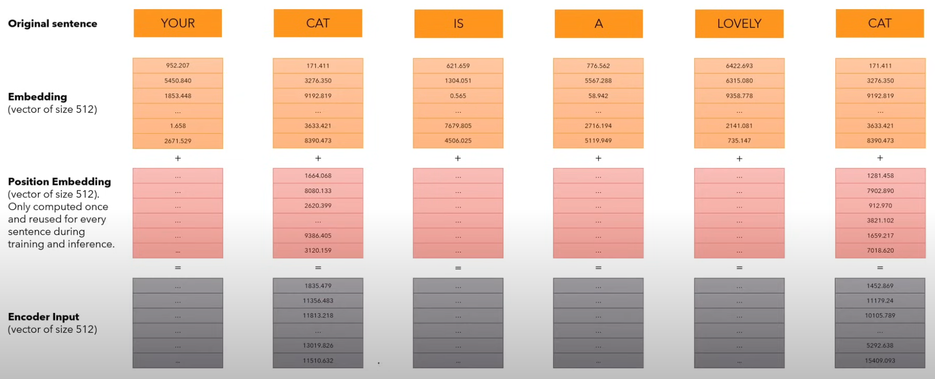
Add Positional Encoding

Slide 4
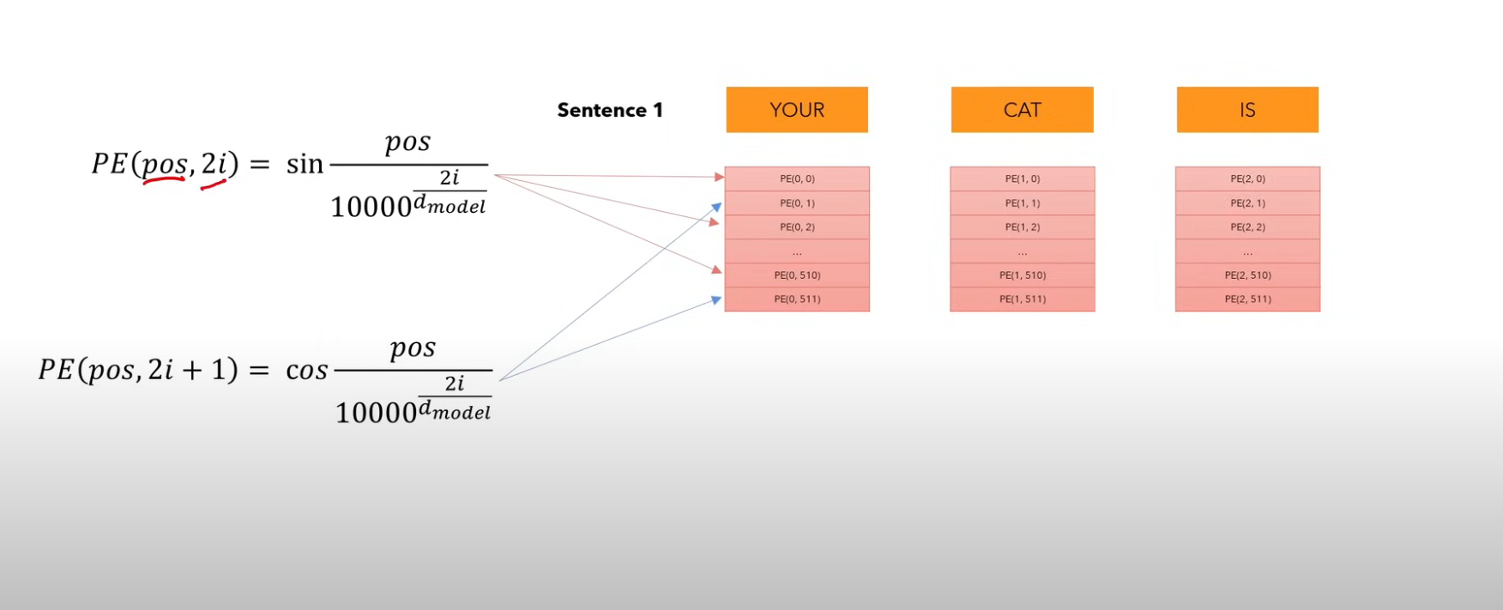
What is Positional Encoding

Slide 5
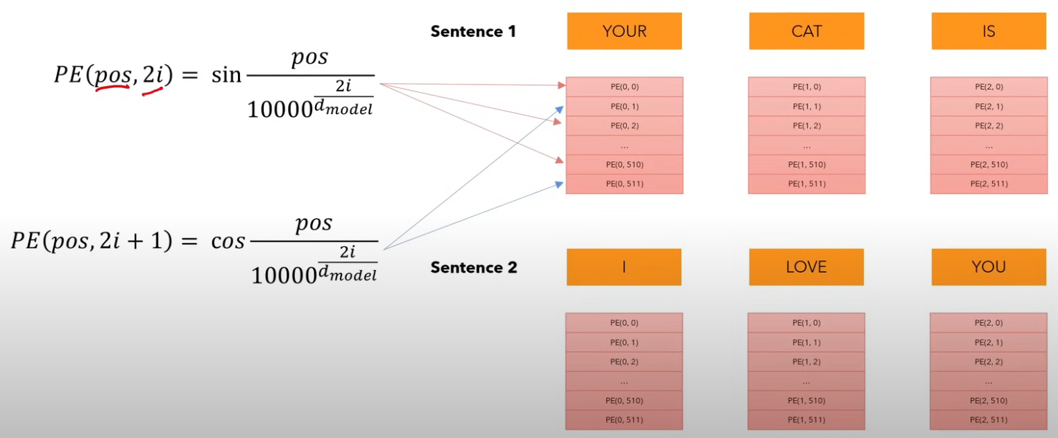
The Same Positional Encoding for Sentence 2

Slide 6
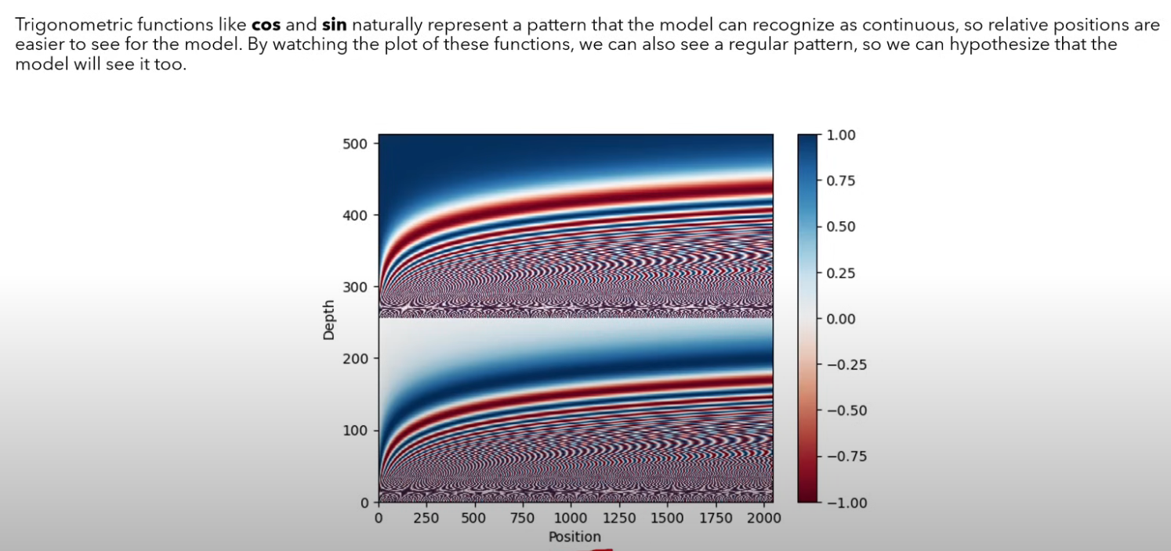
Why Trigonometric Functions

Slide 7
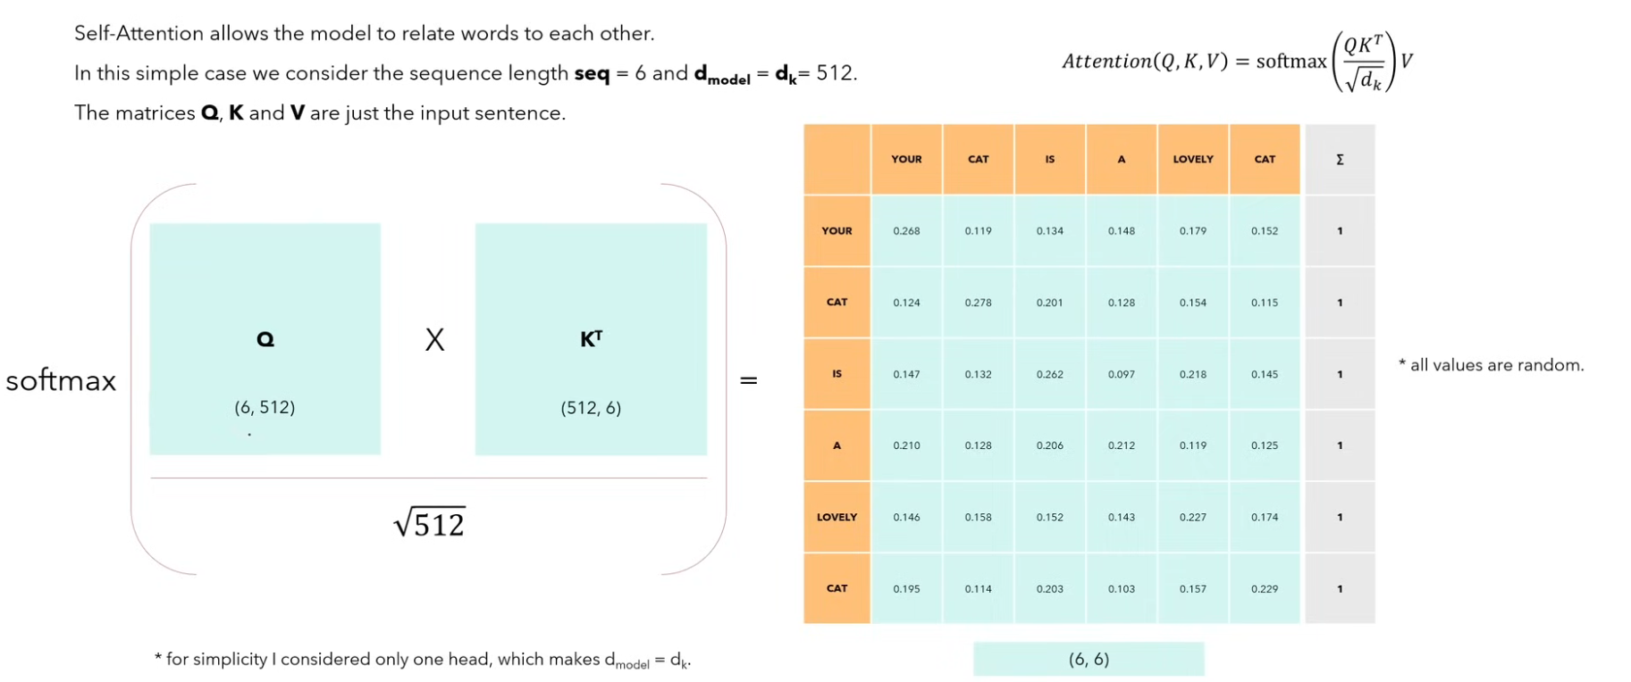
What is Self-Attention?
Each value in the matrix represent the dot products between words

Slide 8
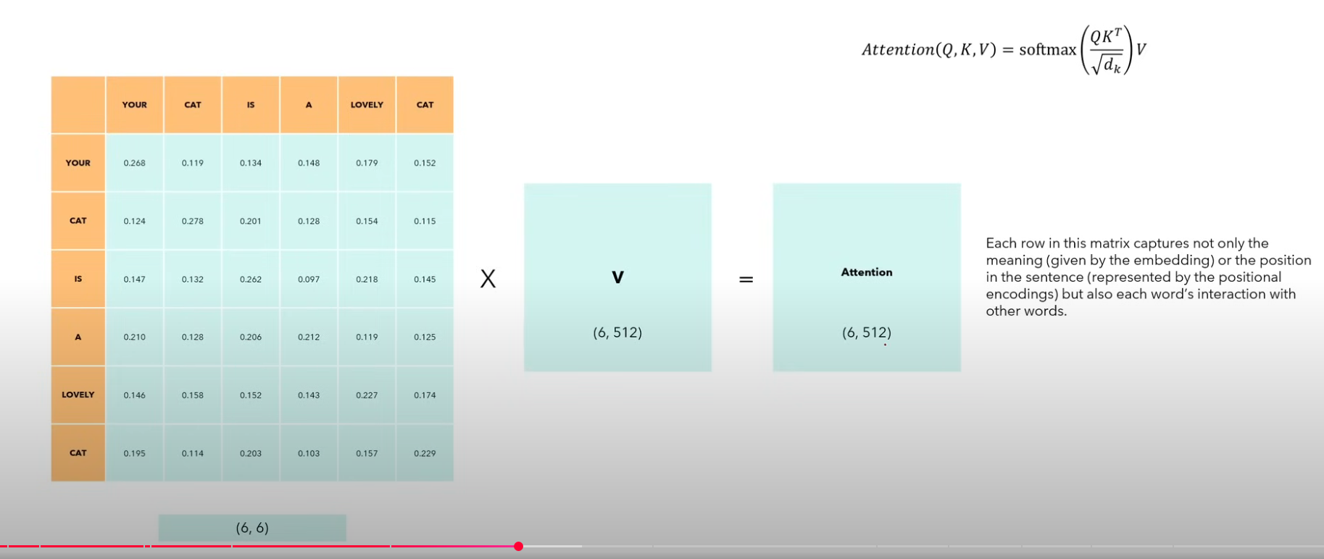
What is Self-Attention?
The new matrix captures the relation of every word with all the other words

Slide 9
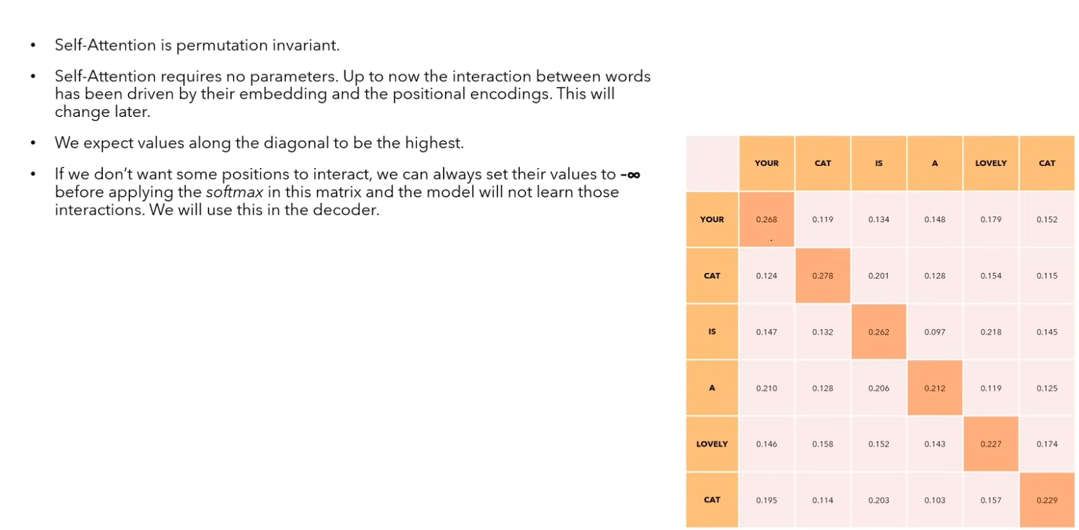

Slide 10
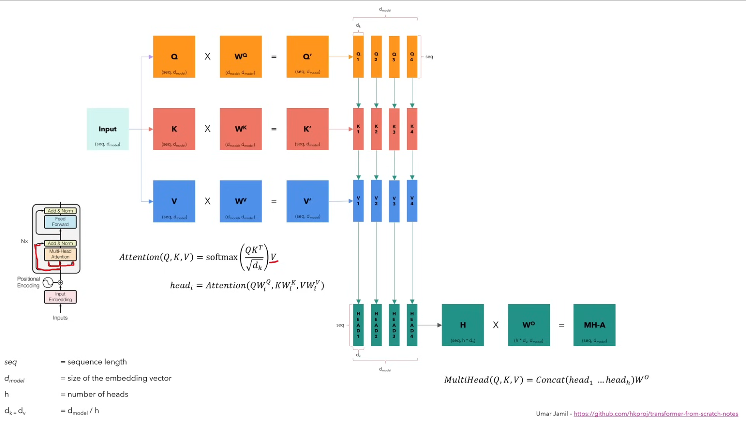

Slide 11
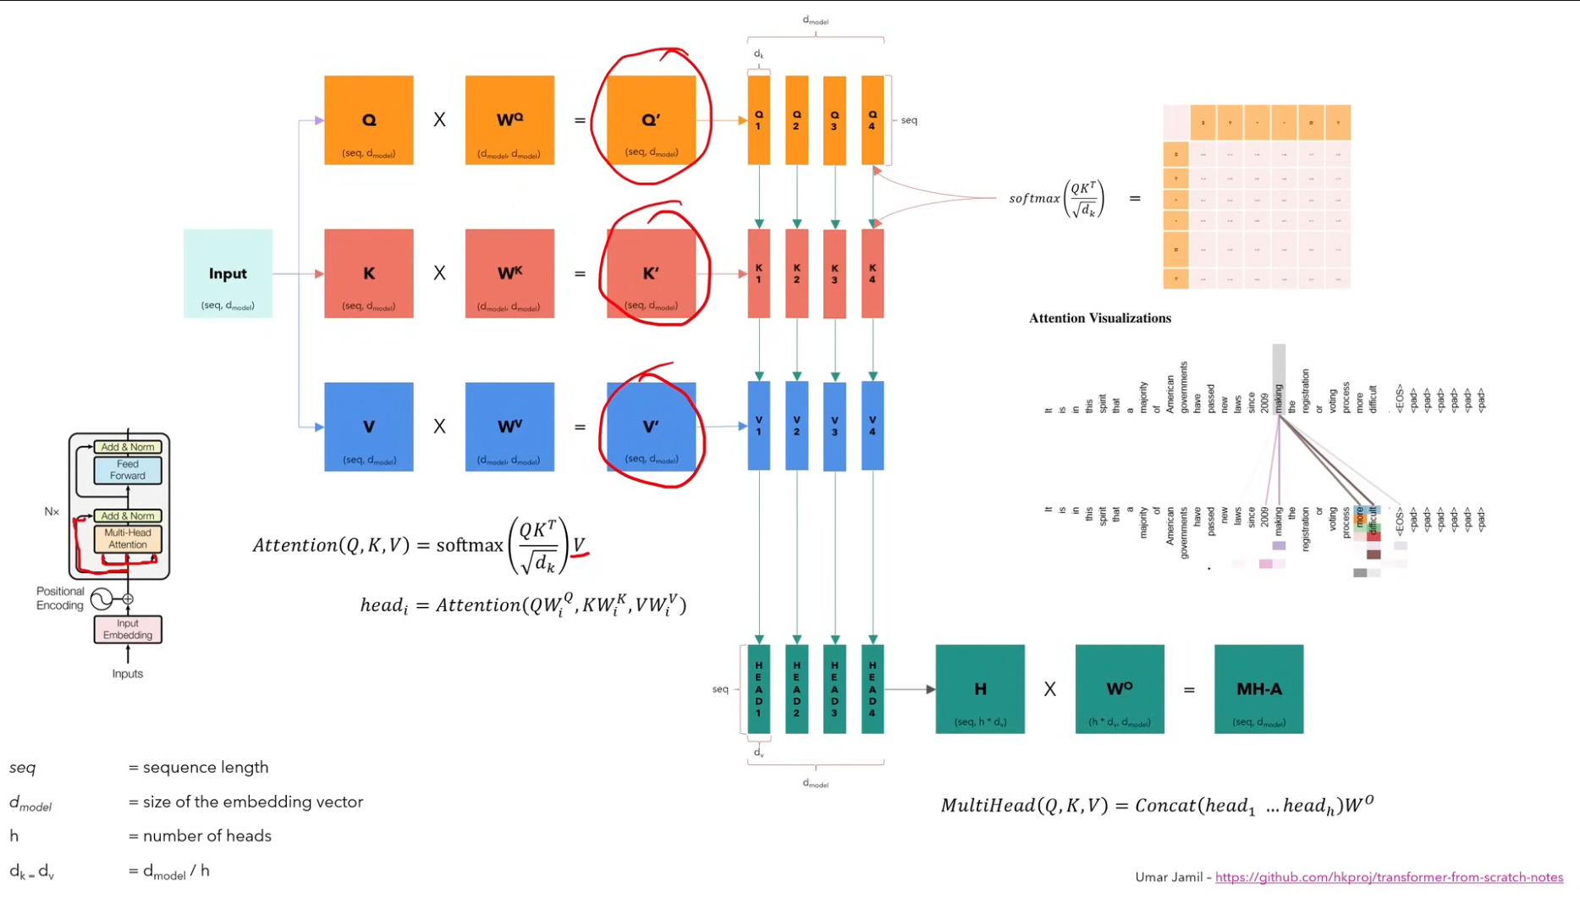

Slide 12
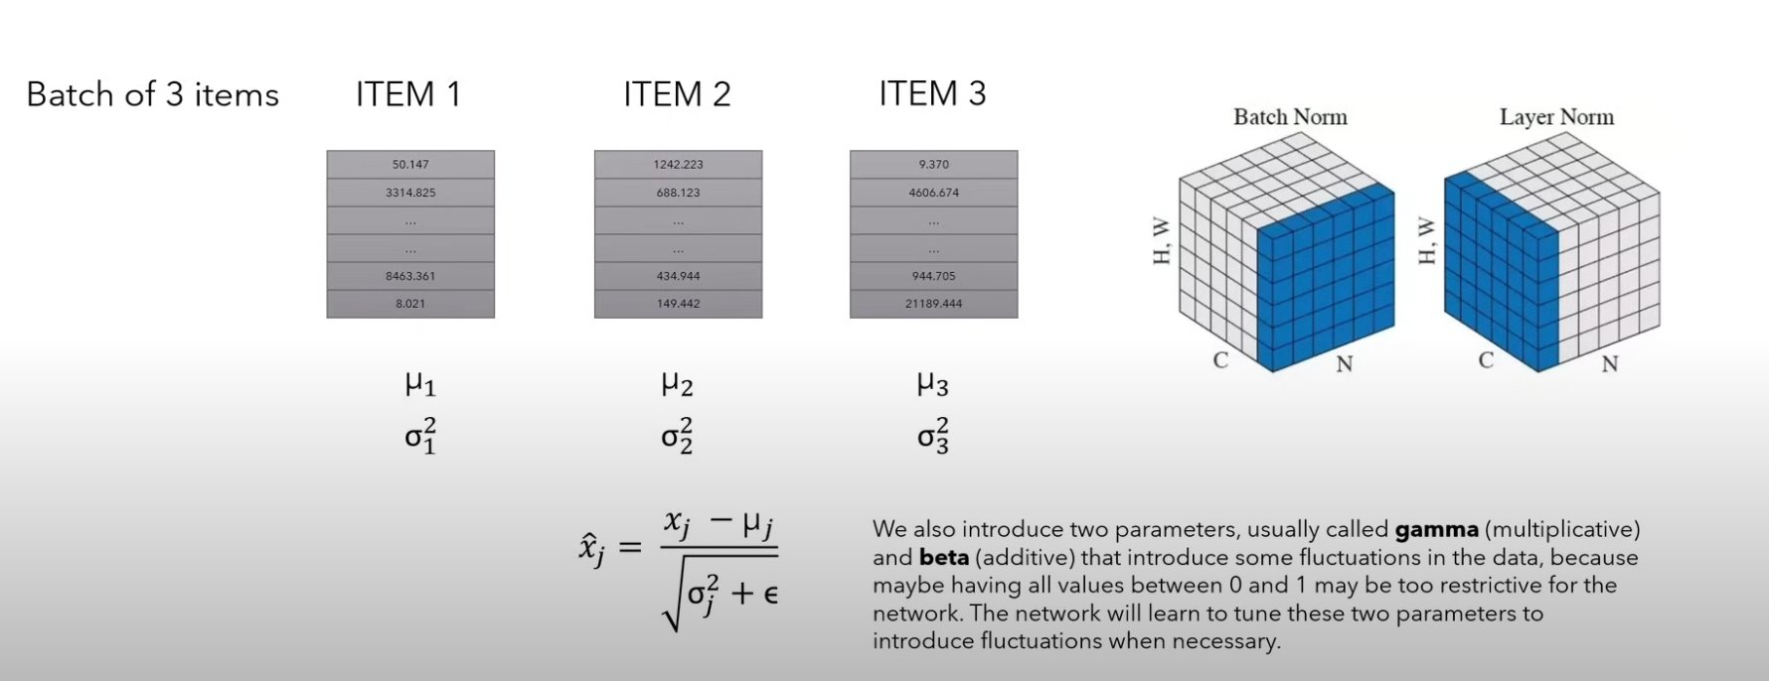
What is Layer Normalization?

Slide 13
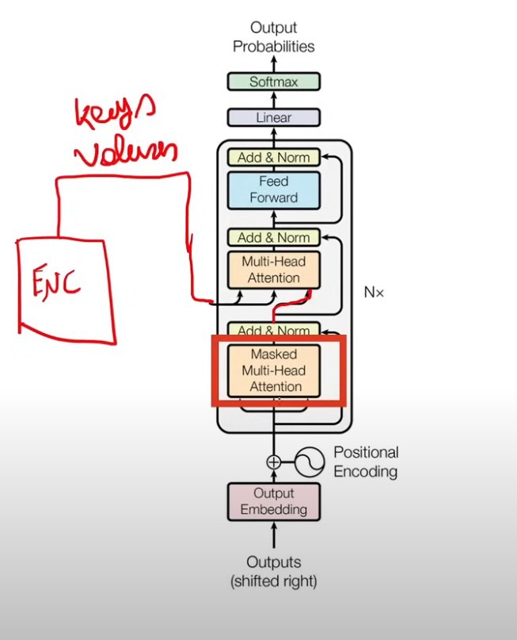

Slide 14
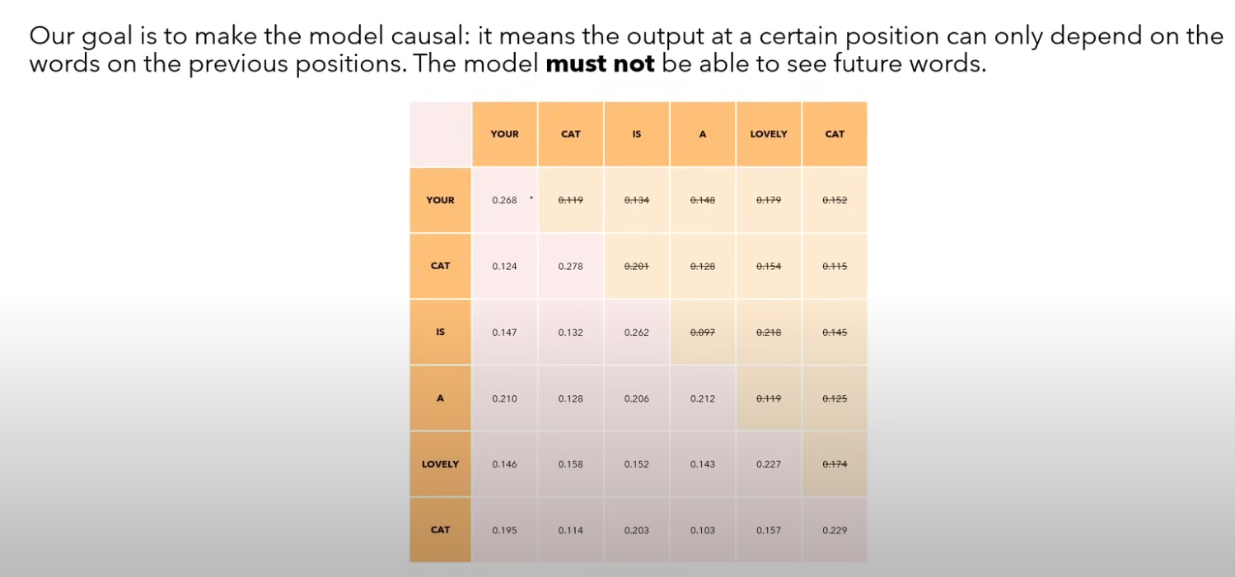
Masked Multi-Head Attention

Slide 15
Training Example

Slide 16
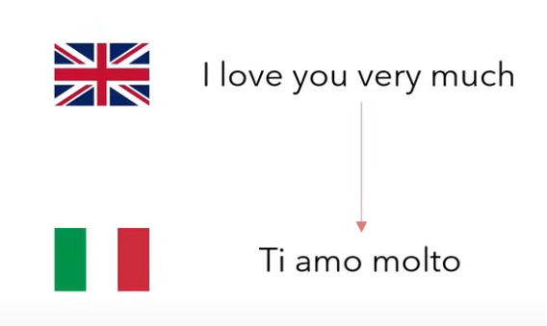

Slide 17
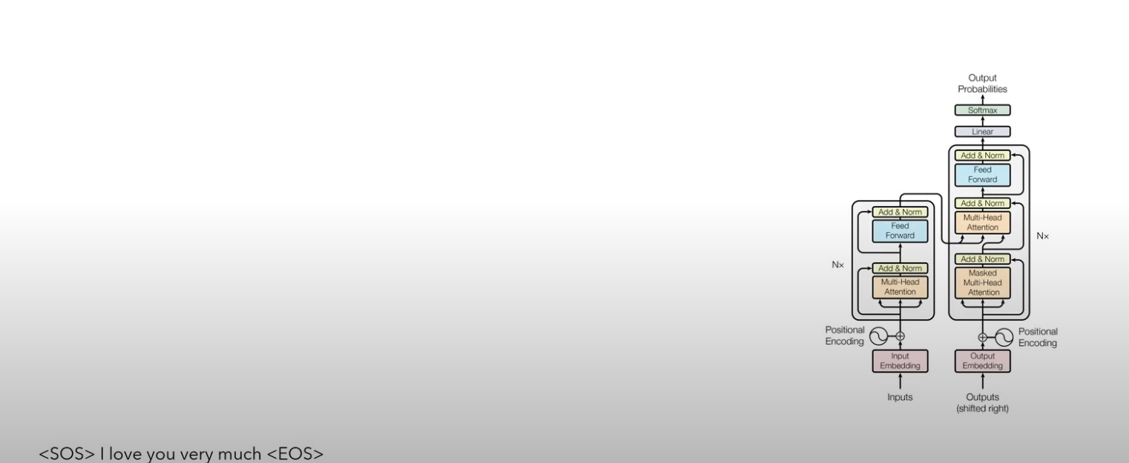
Prepend special tokens

Slide 18
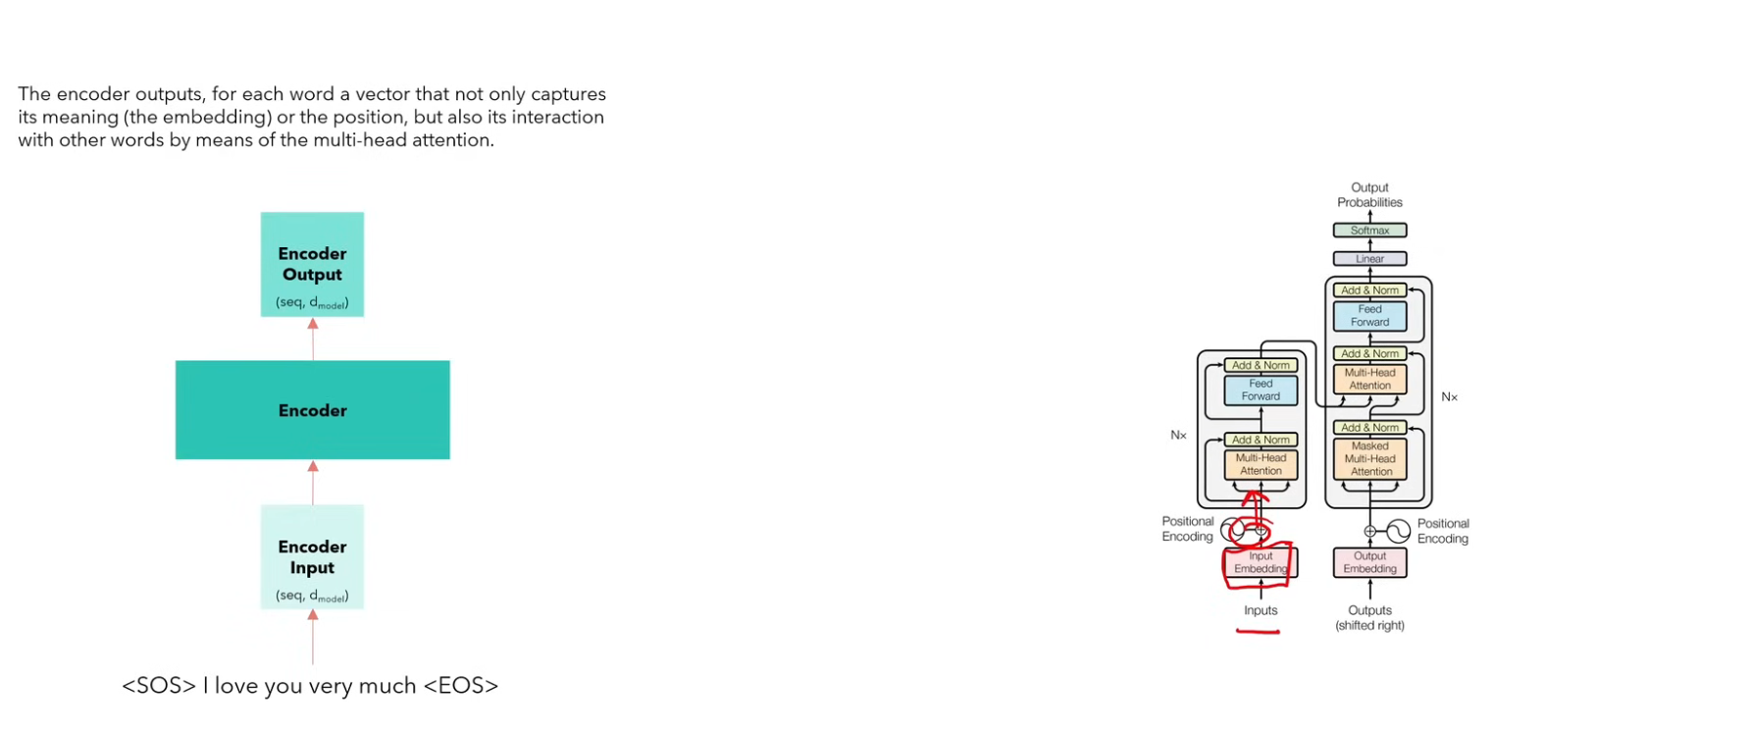
The Encoder Output
The Encoder captures the meaning, the position and the Interactions with all the other words​

Slide 19
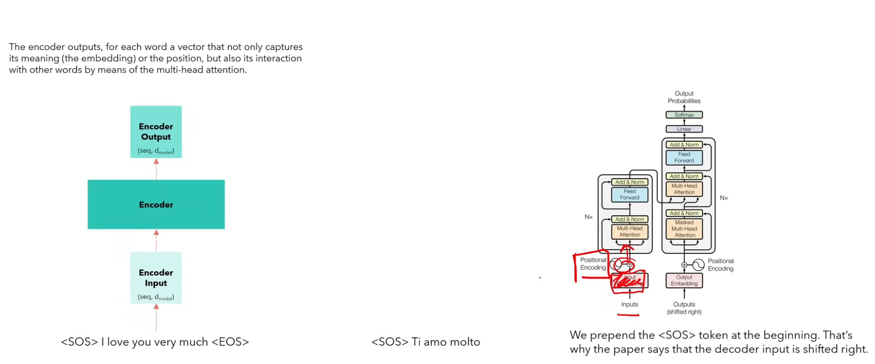
Now the Decoding Procs

Slide 20
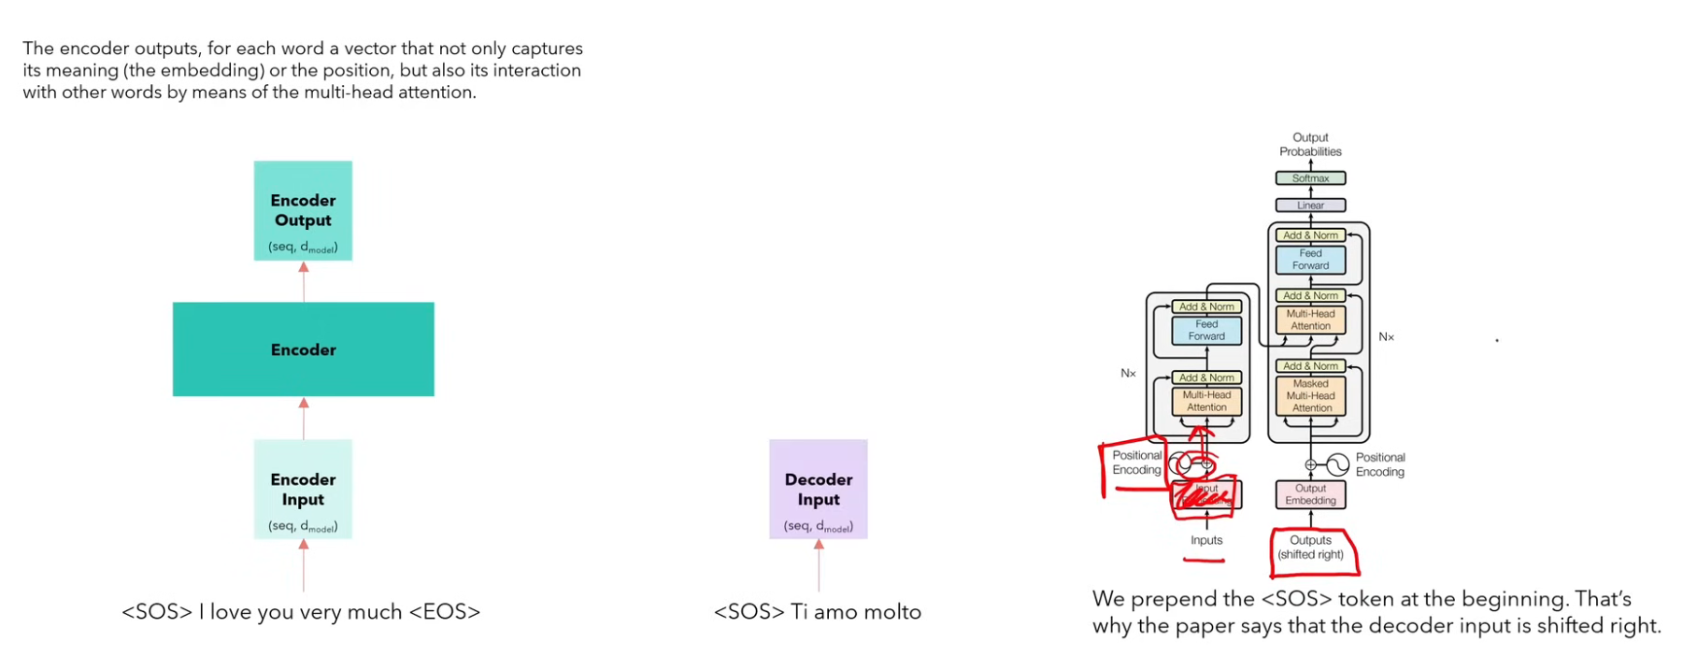

Slide 21
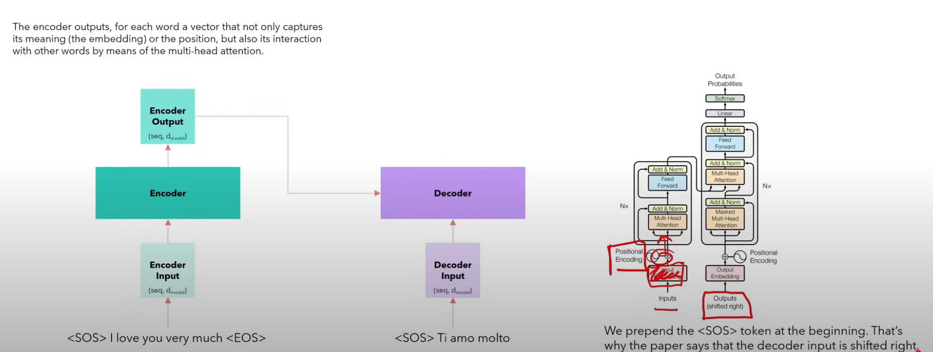

Slide 22
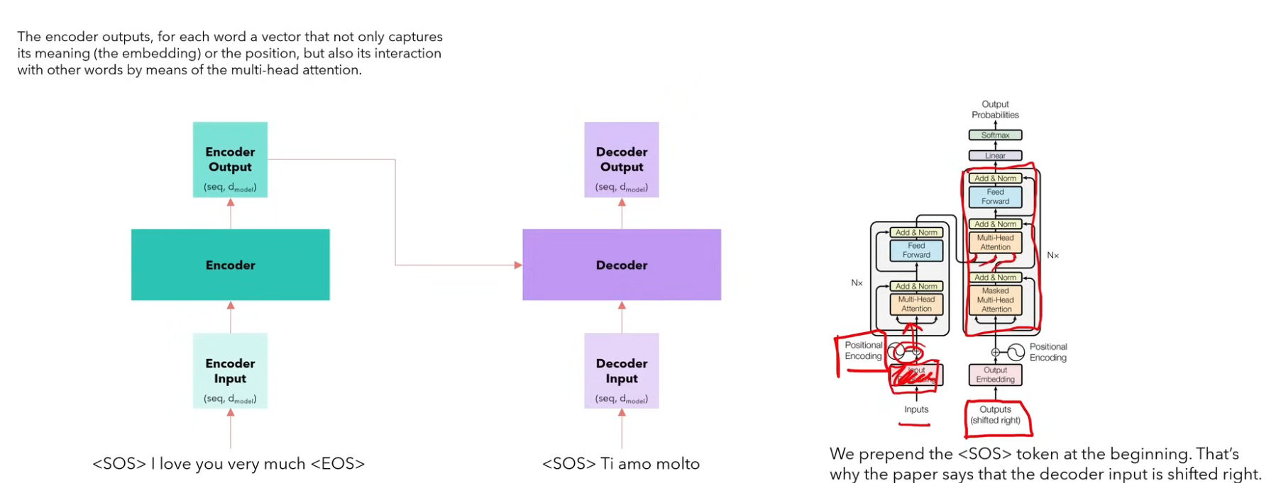
The Output of the Big Decoder Wolck will be a Matrix just like in the Encoder

Slide 23
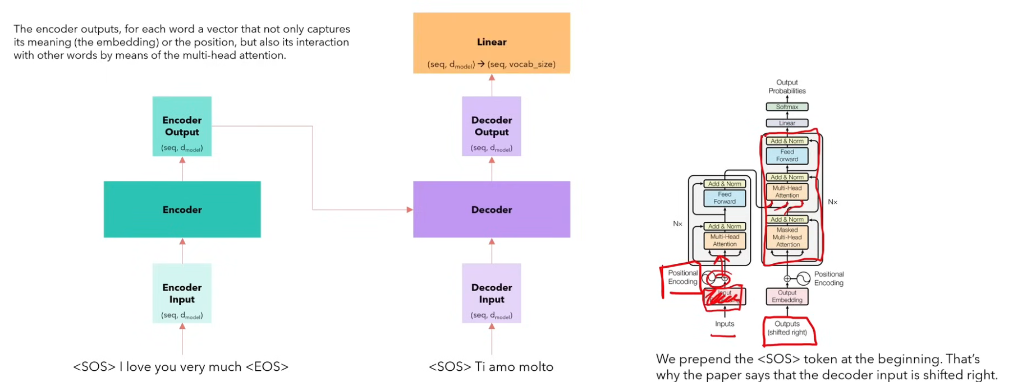
We Use a Linear Layer to Map the Decoder Output to the Vocabulary

Slide 24
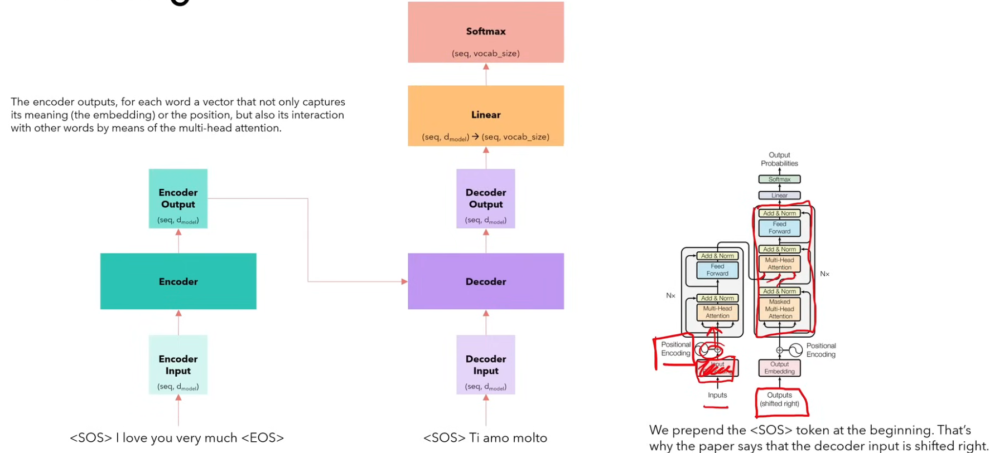
Use the Softmax to Convert Outputs into Probabilities

Slide 25
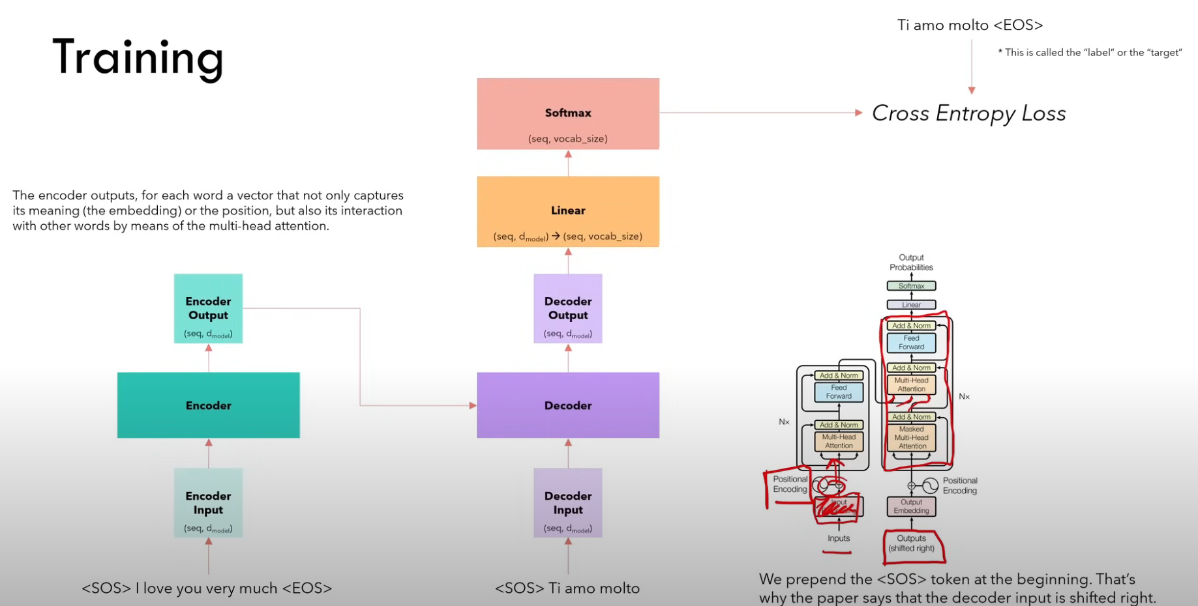
Then Compute the Loss

Slide 26
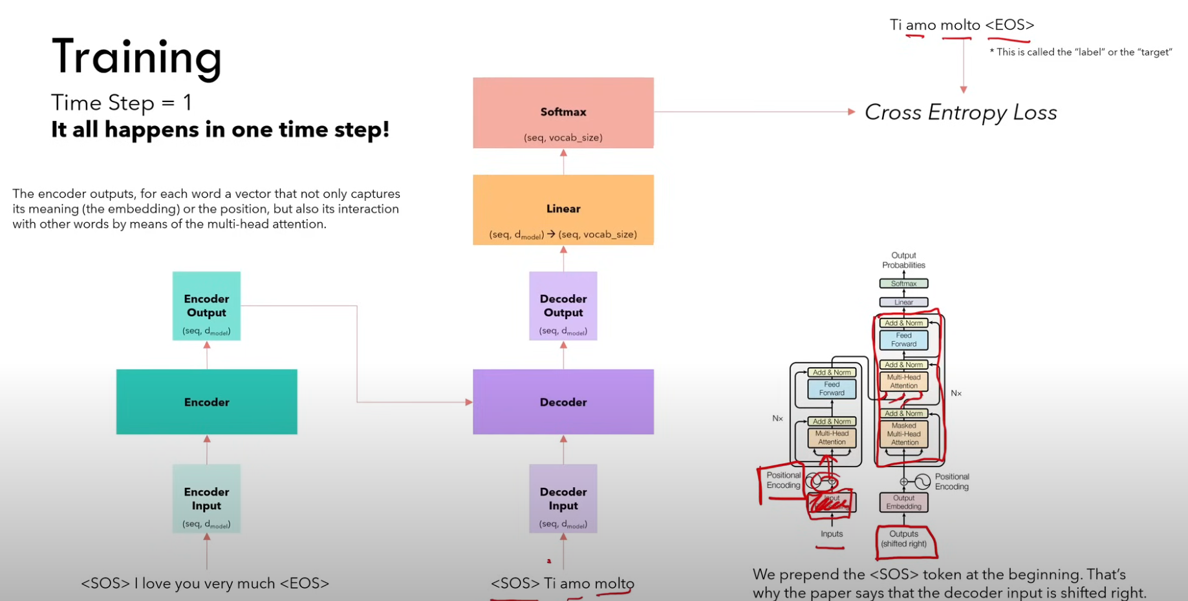
It All happened in One Time Step Not Like RNNs

Slide 27
How Inference Work

Slide 28
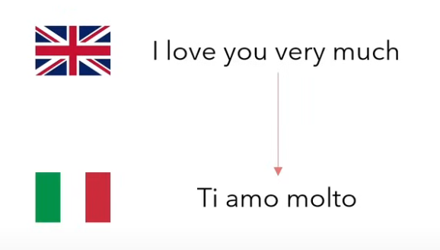
We Want to Translate the English Sentence into Italian

Slide 29
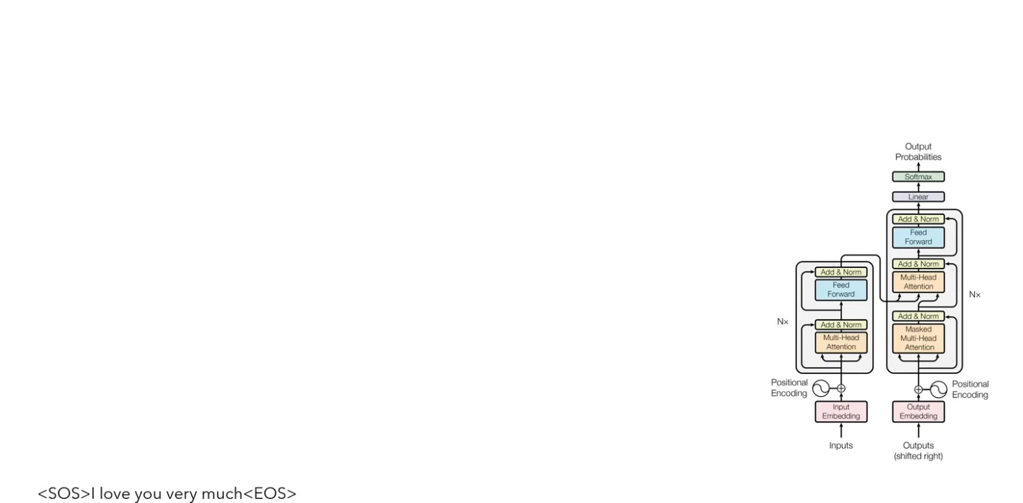
We Prepare the Encoder, We Add the Special Tokens to the Sentence

Slide 30
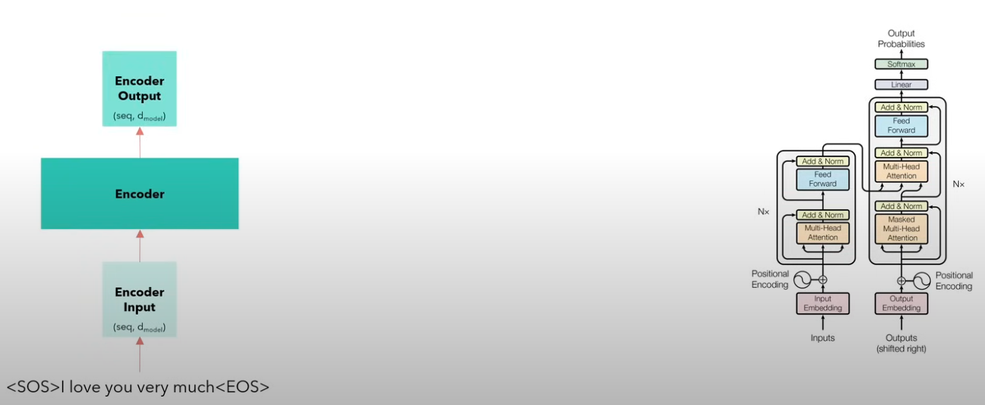
We Do the Encoding
The Encoder captures the meaning, the position and the Interactions with all the other words​

Slide 31
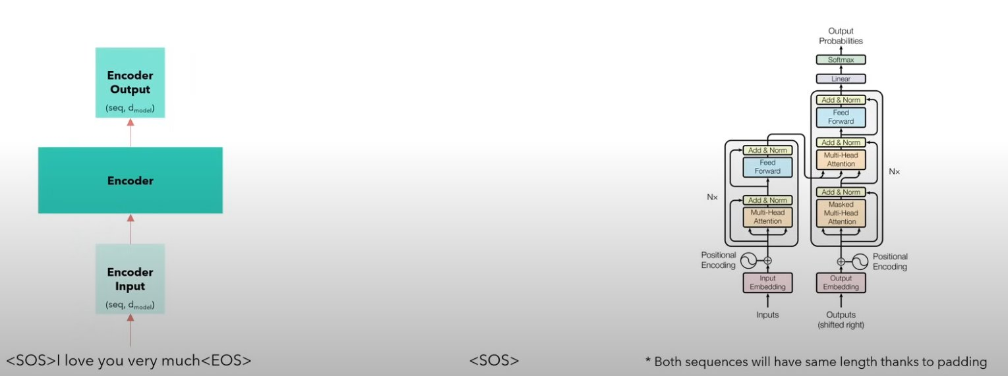
The Decoder Process
For the decoder, we just give the start of sentence token, and pad the input to the input length

Slide 32
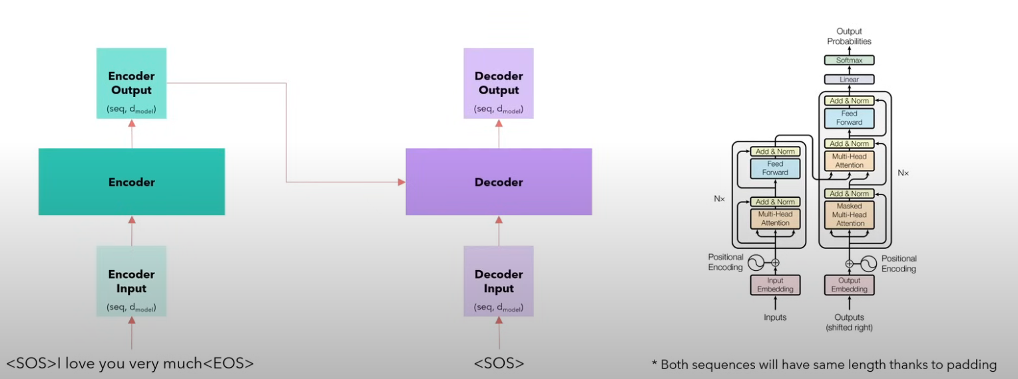
The decoder will process the input and at certain stage it will receive the Keys and the Values (Cross Attention) from the Encoder.

Slide 33
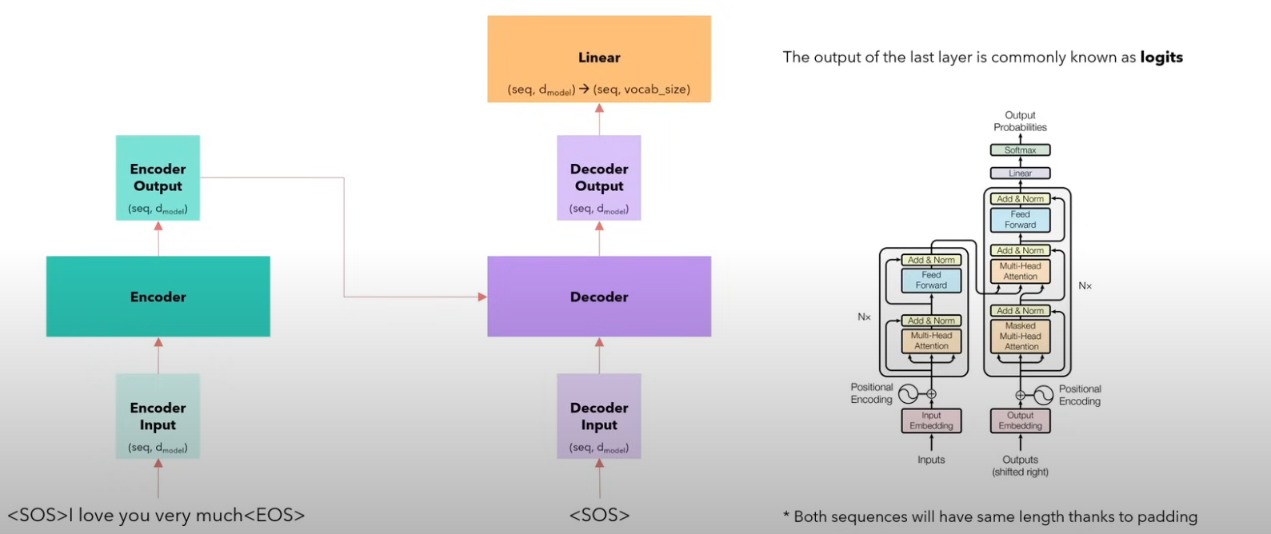
The linear layer will project output back to our vocabulary

Slide 34
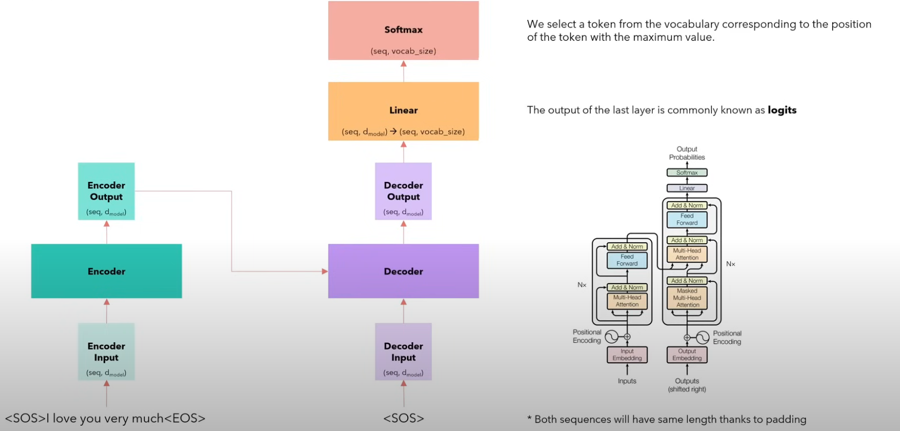
The we apply Softmax which converts logits into probabilities at vocabulary size

Slide 35
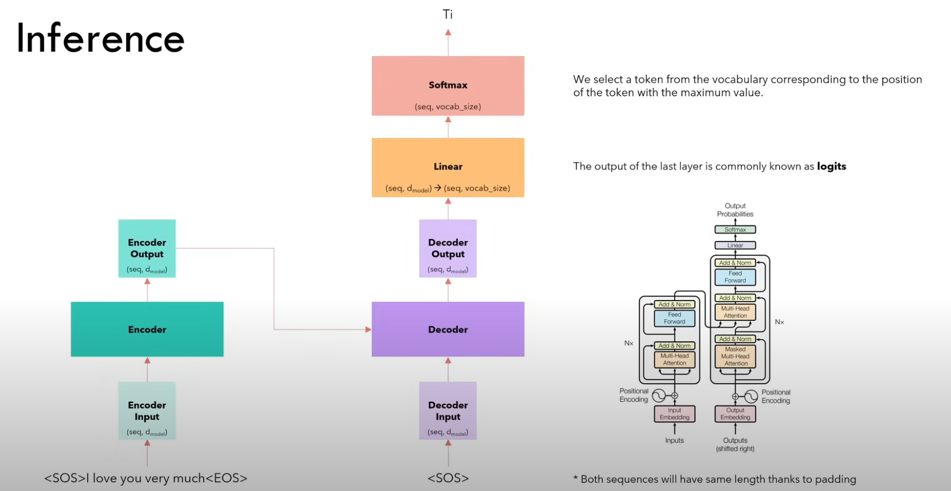
The Softmax hopefully will produce the first token, which is the word Ti in Italian if the model was trained correctly

Slide 36
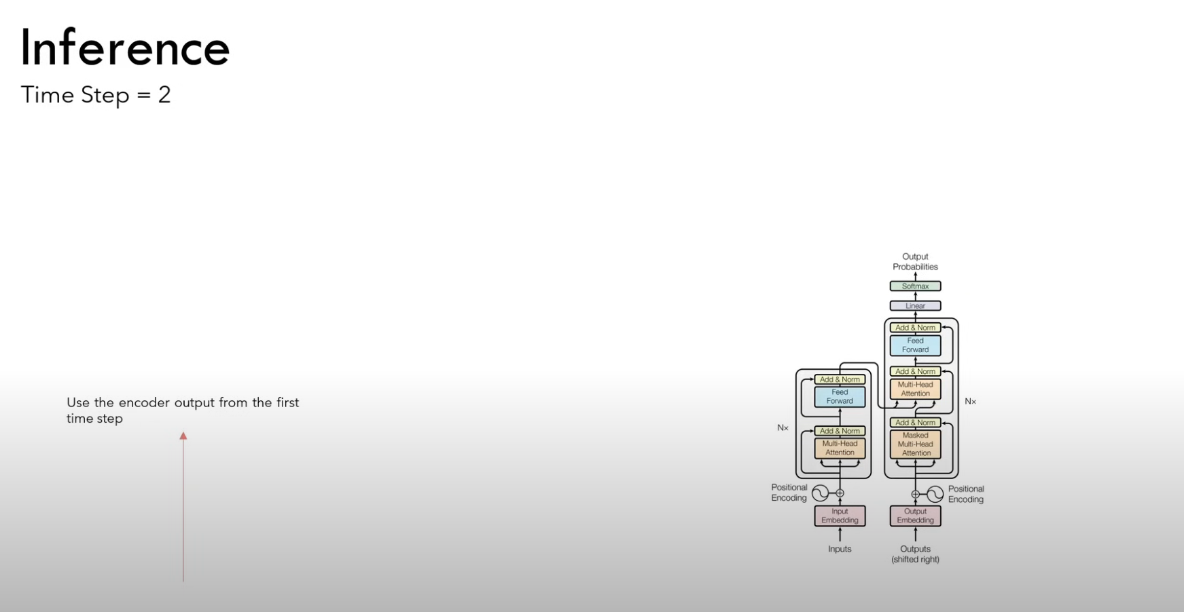
In time step 2, we take the output of the previous decoding process and add it to the input string. The English encoded sentence is already encoded and will be used later

Slide 37
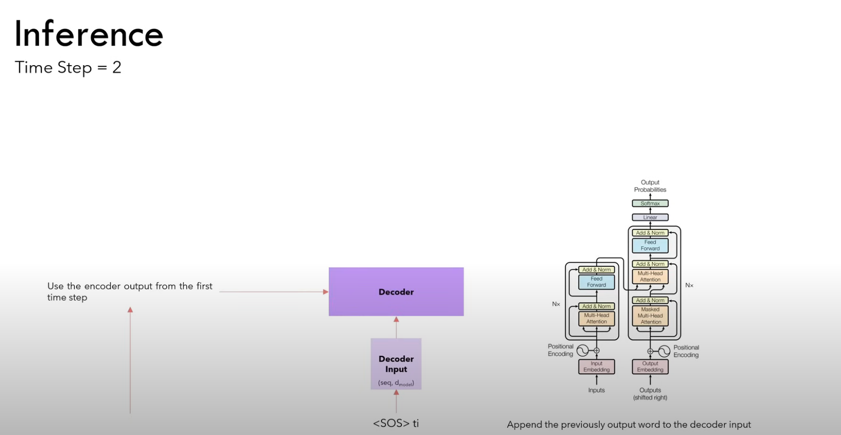
.

Slide 38
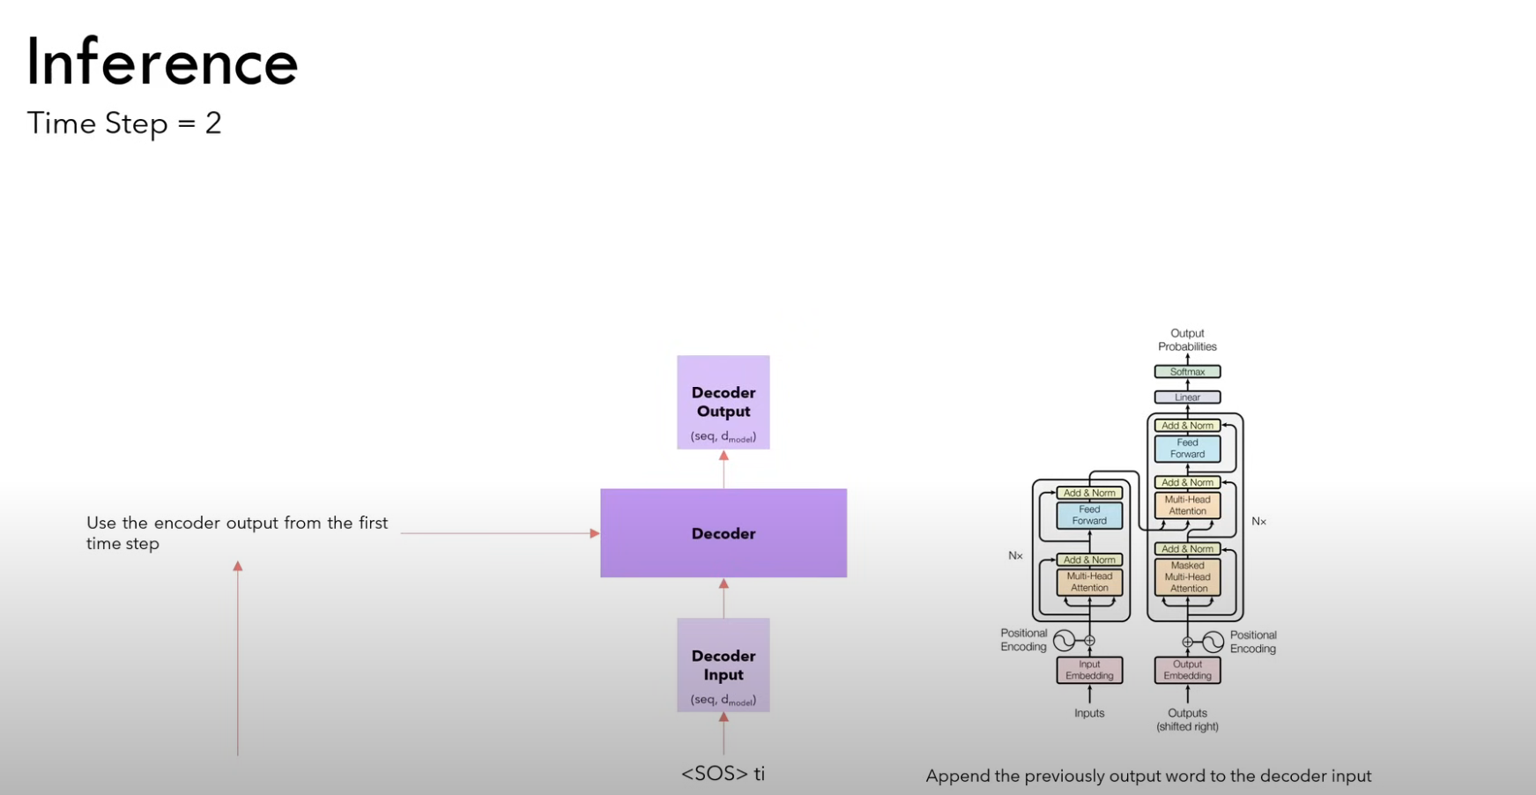
.

Slide 39
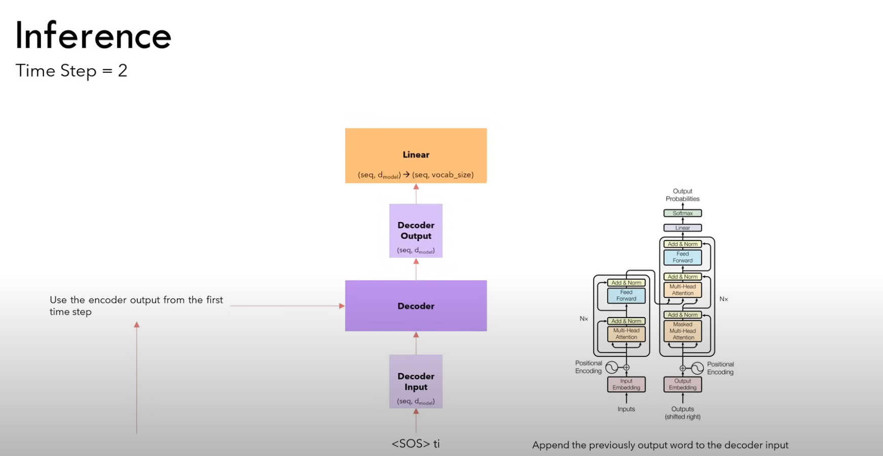
.

Slide 40
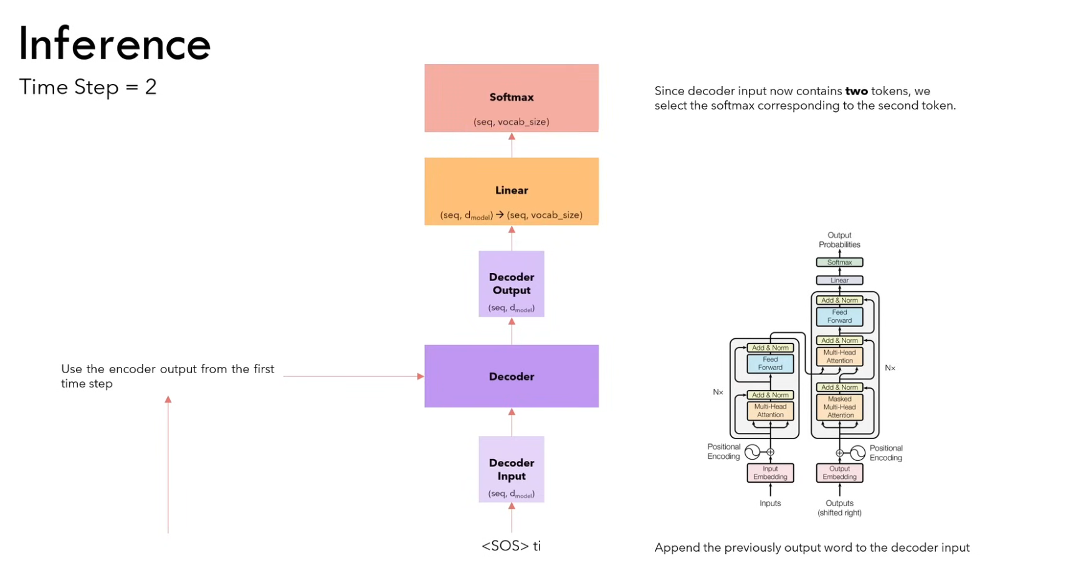

Slide 41
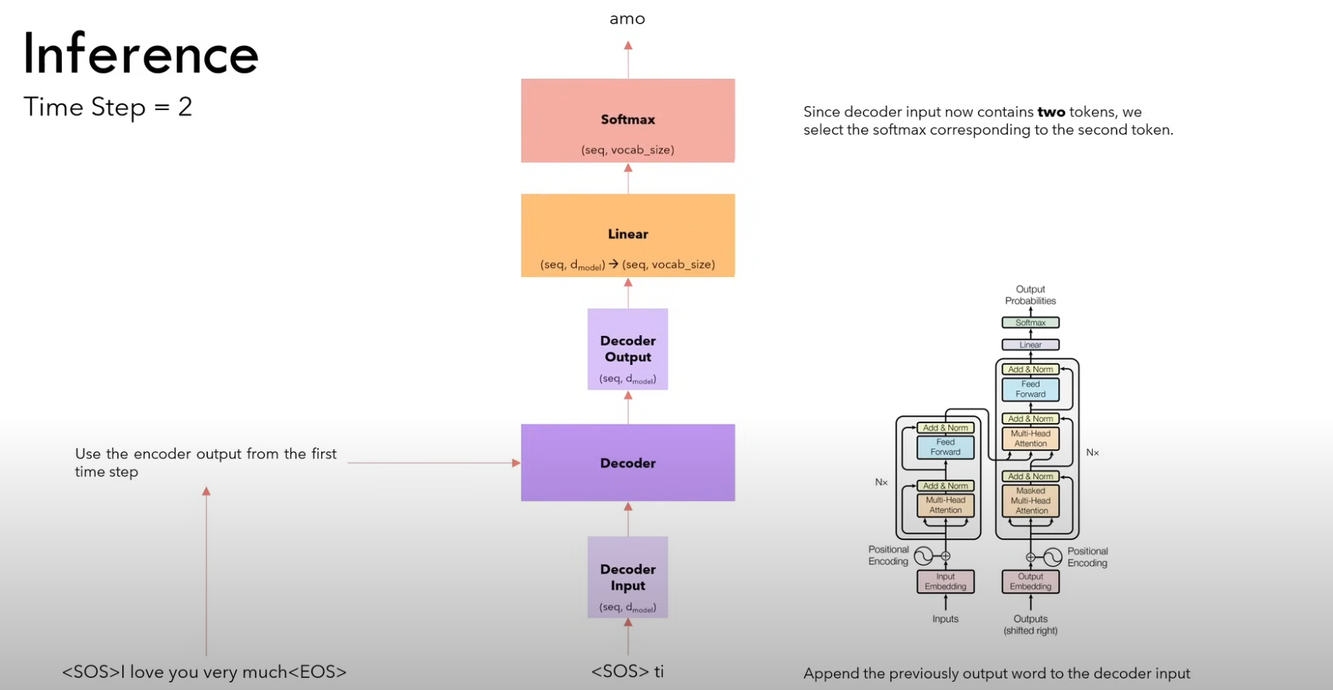

Slide 42
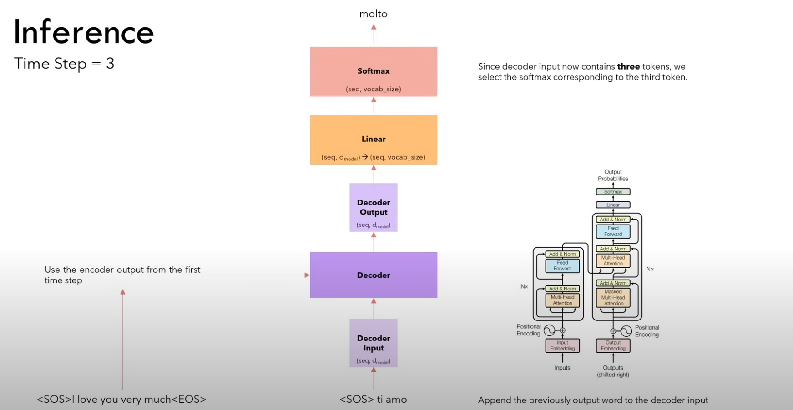

Slide 43

We stop when we see the [EOS] token

